Slide 1
Vegetative Propagation
REVISION FLASH CARDS

Slide 2
Natural Veg. Prop. 4 methods
Stem – runner (or stem tuber)
Root- root tuber
Leaf – plantlets of Mother of Thousands
Bud – bulb

Slide 3
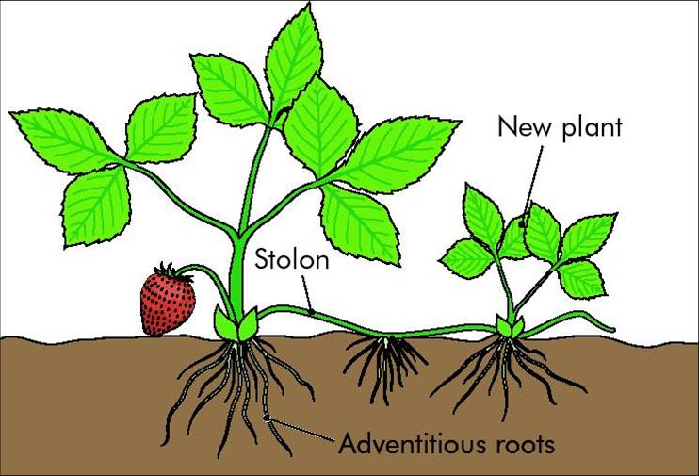
Modified Stem
Runner

Slide 4
Strawberry
Runner

Slide 5
New shoots from Terminal Bud
New roots from Terminal Bud

Slide 6
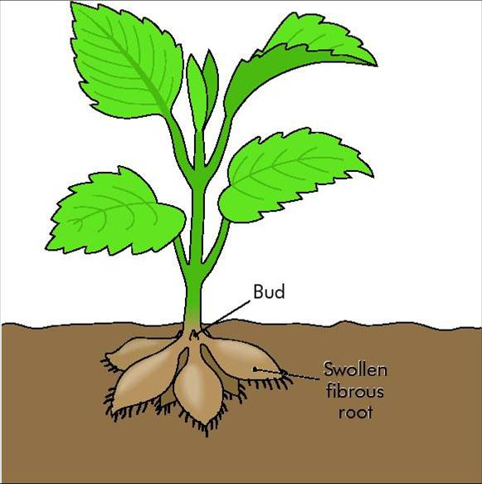
Modified Root

Slide 7
Dahlia
Root
tuber

Slide 8
New shoots from side Bud
(at base of old stem)
swollen fibrous roots
the tuber stores food

Slide 9
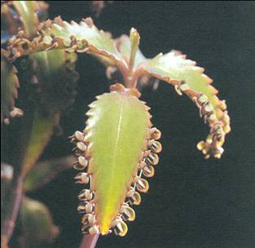
Modified Leaf

Slide 10
Kalanchoe
Plantlets

Slide 11
Plantlets grow on leaf margin
Plantlets Fall off onto soil
Roots develop
Shoots develop

Slide 12
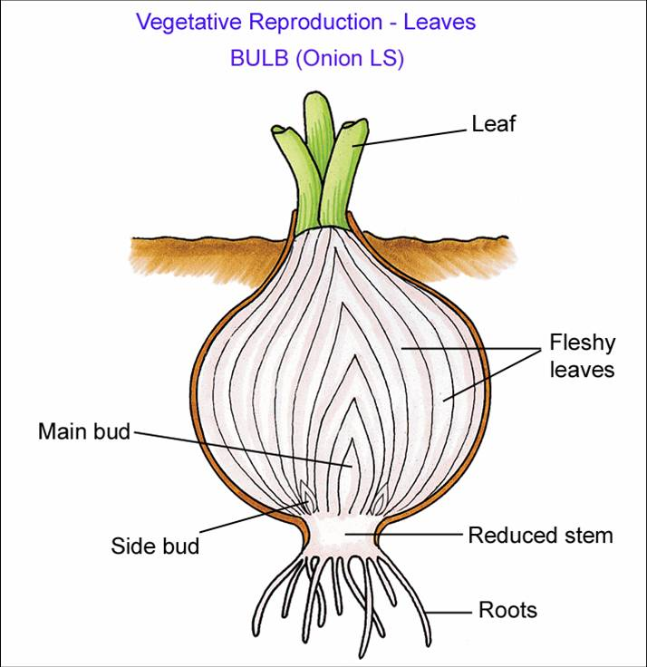
Modified Bud

Slide 13
Onion
Bulb

Slide 14
New shoots from BOTH main bud and side buds
bulb contains an underground stem, reduced in size
Leaves are swollen with stored food

Slide 15
Artificial Veg. Prop. 4 methods
Cuttings
Grafting
Layering
Micro-propagation

Slide 16
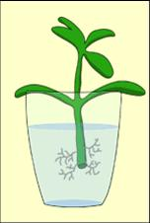
Cuttings
busy lizzie
geranium

Slide 17
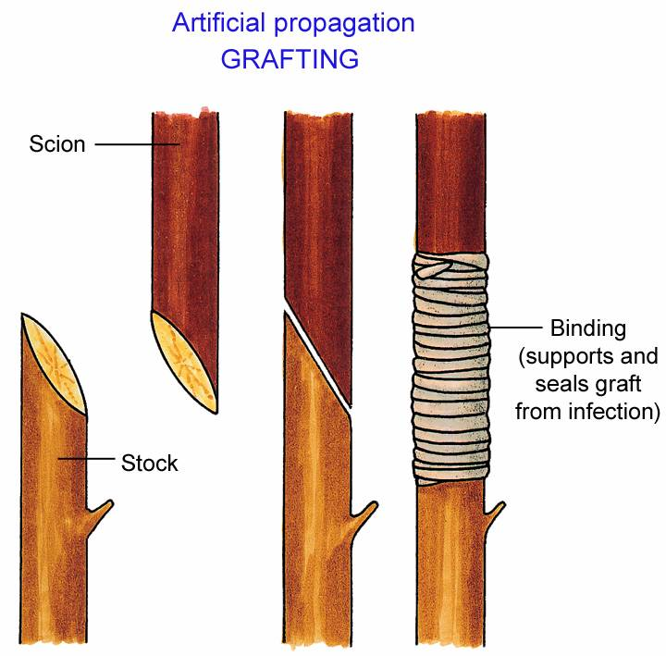
Grafting
(scion) onto (stock)
Useful qualities from both plants combined into one
e.g. apple trees

Slide 18
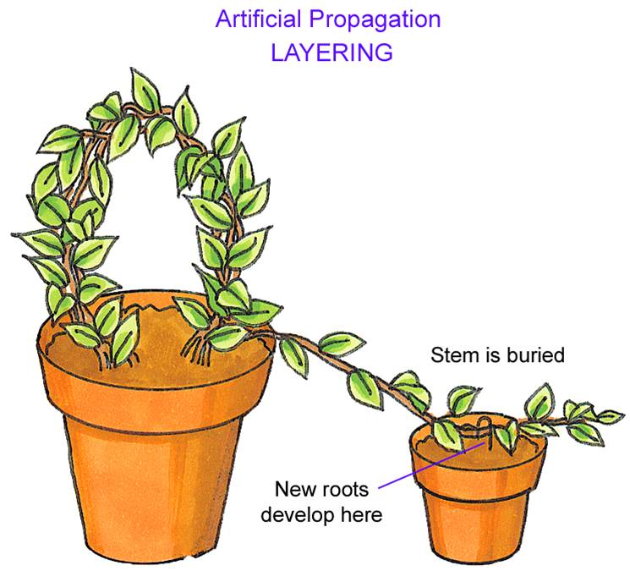
Gooseberry plants

Slide 19
Micro propagation

Slide 20
Vegetative propagation (asexual)
Compared to
Reproduction by seed (sexual)

Slide 21
Variation
No evolution
No variation
Evolution

Slide 22
Slower
Veg. Prop
Faster
By Seed
More competition
Less overcrowding

Slide 23
Outside agents
No waste
No outside agents
Risky

