Slide 1
Vegetative Propagation
Asexual Reproduction in Plants
Offspring produced from one parent
No mixing of genes

Slide 2
Natural Veg. Prop. 4 methods
Stem – runner (or stem tuber)
Root- root tuber
Leaf – plantlets of Mother of Thousands
Bud – bulb

Slide 3
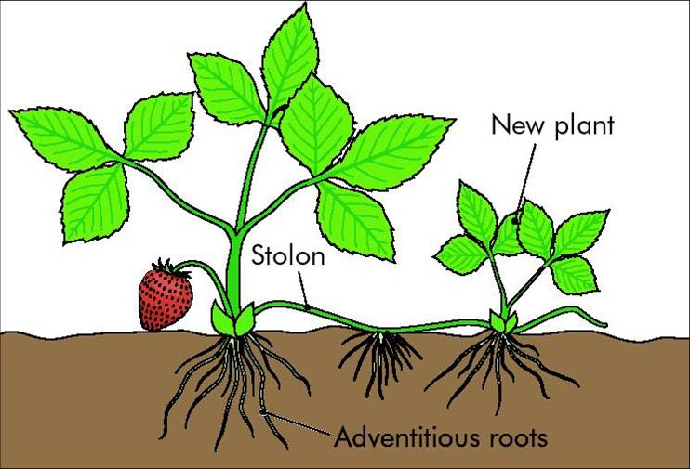
Modified Stem
Strawberry
Runner
New shoots from Terminal Bud
Runner
New roots from Terminal Bud

Slide 4
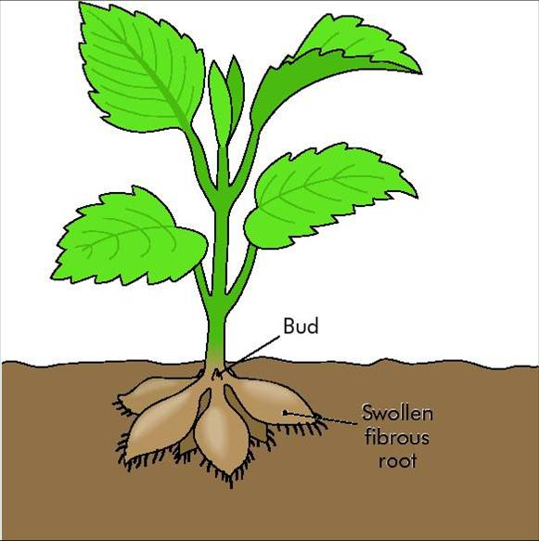
Modified Root
Dahlia
Root tuber
New shoots from side Bud
(at base of old stem)
swollen fibrous roots
the tuber stores food
Be Careful with carrots & parsnips!!
They store food but are NOT reproductive organs

Slide 5
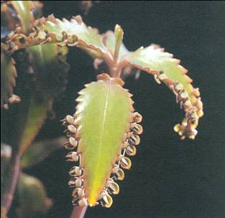
Modified Leaf
Kalanchoe
Plantlets
Plantlets grow on leaf margin
Plantlets Fall off
Roots develop
Shoots develop

Slide 6
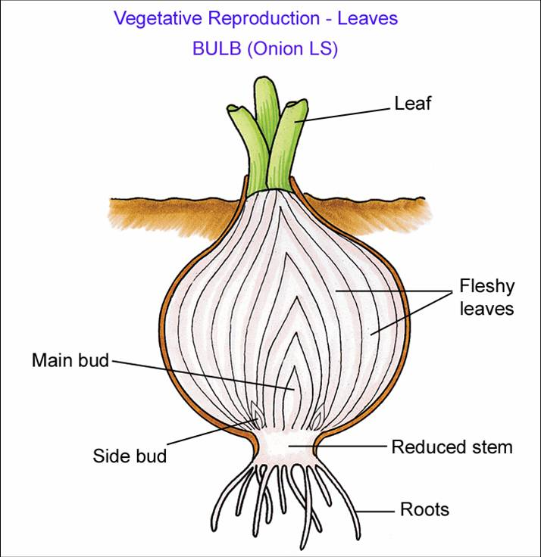
Modified Bud
Onion
Bulb
New shoots from BOTH main bud and side buds
bulb contains an underground stem, reduced in size
Leaves are swollen with stored food

Slide 7
Artificial Veg. Prop. 4 methods
Cuttings
Grafting
Layering
Micro-propagation

Slide 8
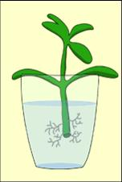
Cuttings
Parts of a plant (usually shoots) removed from plant allowed to form new roots and leaves
rooted in water, well-watered compost, or rooting powder
e.g. busy lizzie, geranium

Slide 9
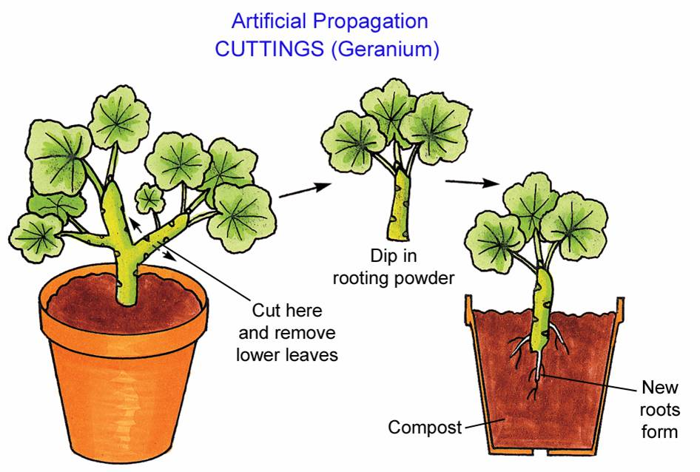

Slide 10
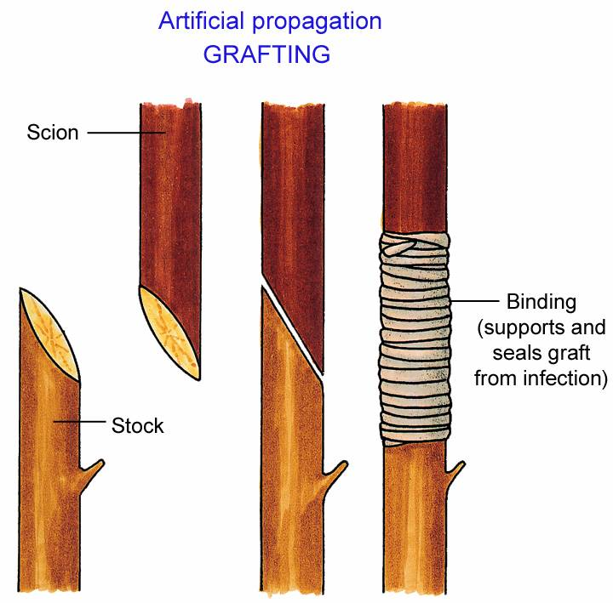
Grafting
Part of one plant (scion) is removed and attached to a healthy, rooted part of a second plant (stock)
Useful qualities from both plants combined into one e.g. rose flower and thorn-less stem
e.g. apple trees

Slide 11
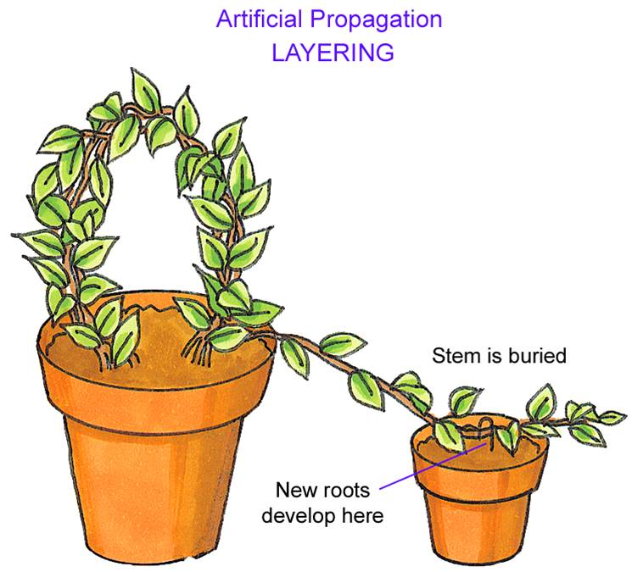
Gooseberry plants

Slide 12
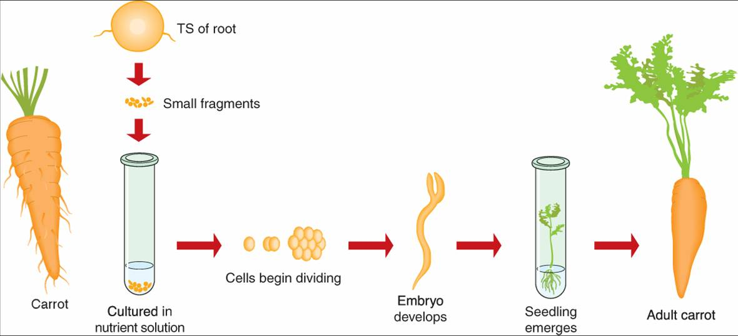
Micro propagation

Slide 13
COMPARE
Vegetative propagation (asexual)
to
Reproduction by seed (sexual)

Slide 14
By Seed
Veg. Prop
Variation
No variation
Not all susceptible to same disease
All susceptible to same disease – no evolution
Allows for evolution
Offspring genetically identical to parent – same traits e.g. golden delicious apples
Slower
Faster
Outside agents needed for seed dispersal, pollination
No outside agents needed
More risky & wasteful
Reliable & No waste
Dispersal reduces overcrowding & competition
Overcrowding & competition

Slide 15
Sexual (seed) | Asexual (vegetative)
Cross pollination ensures variation (allows evolution) | No variations – can be advantage in commercial horticulture
More resistant to disease | All plants are of same species susceptible to disease
Dispersal reduces competition | Overcrowding and competition
Seeds can remain dormant and survive unfavourable conditions | No seeds formed – no dormancy

Slide 16
Sexual (seed) | Asexual (vegetative)
Complex process | Simple process
Depends on outside agents for seed dispersal | No outside agents needed
Slow growth of young plants to maturity | Rapid growth
Wasteful e.g. petals, pollen, fruit | No waste

Slide 17
Cloning
All offspring genetically identical - produced asexually
Clones are produced by mitosis
All the offspring from the various methods of vegetative reproduction (both natural and artificial) mentioned are examples of clones

