Slide 2
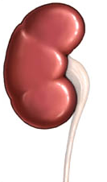
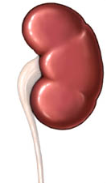
understand the structure and function of the urinary system: bladder, renal artery, renal vein, ureter, urethra and kidney
renal vein
renal artery
kidney
structure
ureter
bladder
bladder
urethra
urethra

Slide 3
function of the urinary system: bladder, renal artery, renal vein, ureter, urethra and kidney
renal artery carries blood to kidney
renal vein carries blood from kidney
kidney filters blood to remove urea
function
ureter transports urine to bladder
bladder
bladder stores urine
urethra releases urine
urethra

Slide 4
The products of excretion: CO2, water and urea
carbon dioxide and water are waste products of the process of respiration in all the cells of the body
respiration
glucose
cell
carbon dioxide
water
energy
oxygen

Slide 5
the carbon dioxide and some of the water is carried to the lungs by the blood to be excreted
o
c
o
o
o
o
H
H
H
c
H
o

Slide 6
urea, which is toxic, is produced in the liver from excess protein
Toxic urea is removed by and carried by blood to the kidney
excess protein from our food is carried from the gut by blood
liver

Slide 7
OB22 understand the function of the skin in the excretion of waste products made in the body
Human skin has sweat glands which lead to pores at the surface – water, salt and a tiny amount of urea is excreted as sweat through these pores
section of skin
pore
sweat gland
blood capillaries

Slide 8
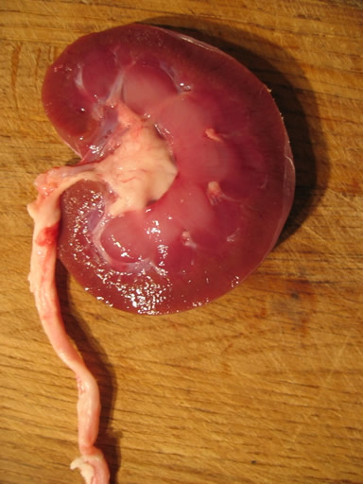

Slide 9
water
salt
2 urea, some salts and water are removed from bloodstream by kidney and form urine
urea
1 blood containing water, salts and urea enters the kidney
3 the urine leaves the kidney in the ureter

Slide 10
OB23 urine is stored in the bladder before being released from the body
urethra

